Slide 1


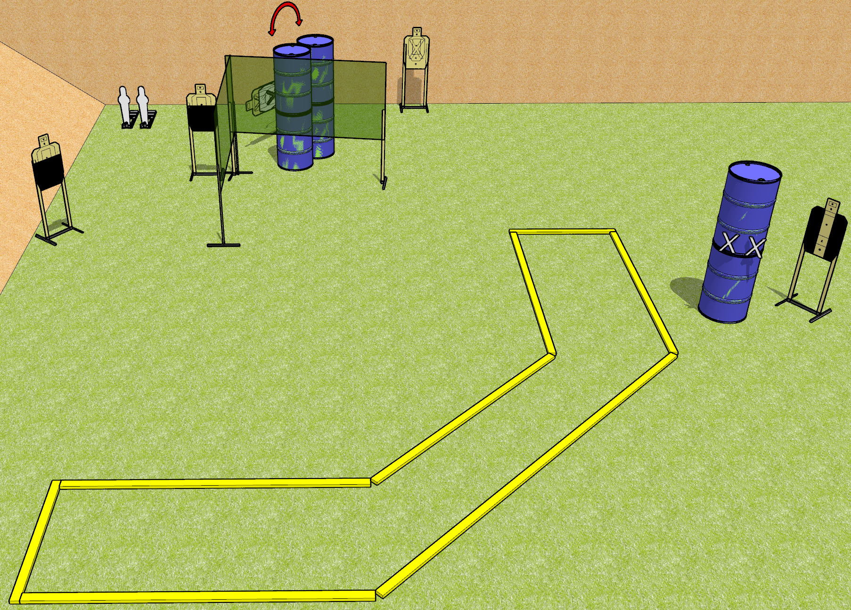
 | Dothan Gun Club – USPSA Match Painfully Partial Course Designer : Drew Coleman
START POSITION : Standing with both hands touching marks on barrel. PCC muzzle touching right hand mark.
GUN READY CONDITION : Pistol loaded and holstered. PCC loaded, shouldered, safety on, muzzle touching right hand mark. |  | SCORING: Comstock, 12 rounds TARGETS: 5 paper, 2 Steel SCORED HITS: Best 2 on paper, steel until down START-STOP: Audible, last shot RULES:
STAGE PROCEDURE: Engage targets as they become available from within the fault lines.

Slide 2
Painfully Partial
Written Stage Briefing
Painfully Partial is a 12 round, 60 point, Comstock Short Course. There are five USPSA targets and two mini poppers. The best two hits on paper will score and steel must fall to score. The start signal is audible.
Handgun start position is standing outside the shooting area with both hands touching marks on barrel. Handgun is loaded and holstered.
PCC start position is standing outside the shooting area with muzzle touching the right hand mark. Loaded carbine is held with both hands, shouldered, safety on.
Upon start signal, engage the targets as they become available from within the shooting area. Either mini popper will activate the swinging target.

Slide 3
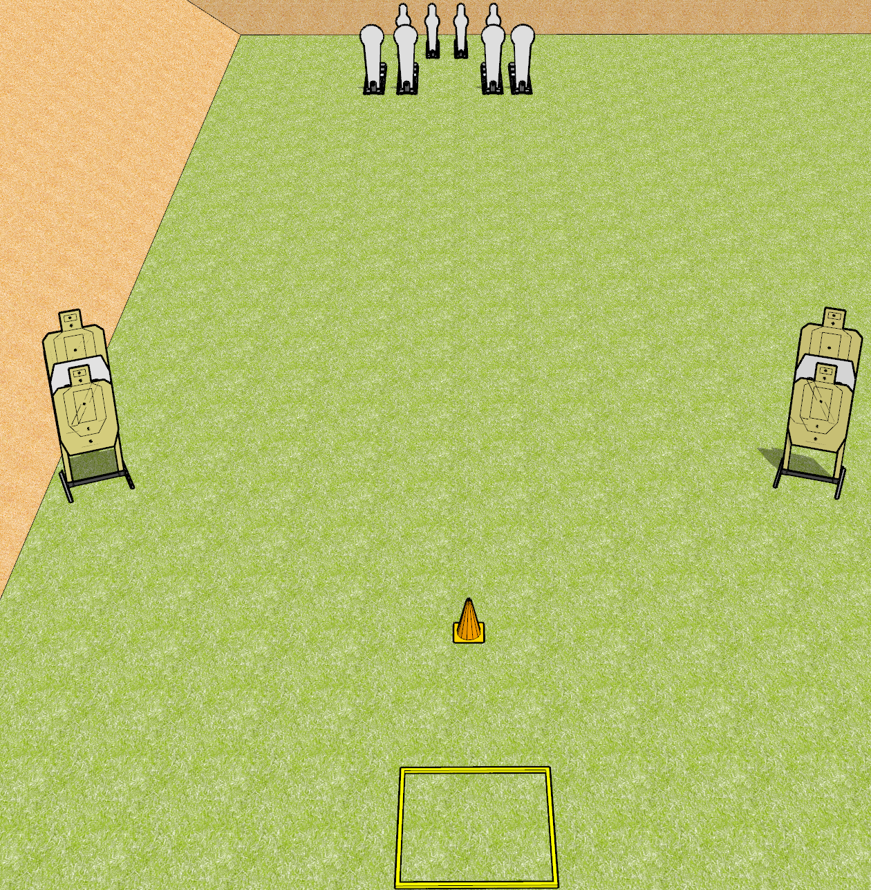
 | Dothan Gun Club – USPSA Match Profoundly Evil Course Designer : Drew Coleman
START POSITION : Standing in shooting box, wrists below belt.
GUN READY CONDITION : Pistol loaded and holstered. PCC loaded, shouldered, safety on, pointed at orange cone. |  | SCORING: Comstock, 16 rounds TARGETS: 4 paper, 8 Steel SCORED HITS: Best 2 on paper, steel until down START-STOP: Audible, last shot RULES: failing to perform a mandatory reload between arrays will be a procedural penalty per shot fired. Failure to fire weak hand/side only will be a procedural per shot fired.
STAGE PROCEDURE: Engage the steel OR the paper, perform a mandatory reload, then engage the remaining array. All paper targets are a single array, all steel is a single array.

Slide 4
Profoundly Evil
Written Stage Briefing
Profoundly Evil is a 16 round, 80 point, Comstock Speed Shoot. There are four USPSA targets, four colt poppers, and four mini poppers. The best two hits on paper will score, and steel must fall to score. The start signal is audible.
Handgun start position is standing in shooting box with wrists below belt. Handgun is loaded and holstered.
PCC start position is standing in shooting box. Loaded carbine is held with both hands, shouldered, safety on, muzzle pointed at orange cone.
Upon start signal, engage either the steel or the paper targets, perform a mandatory reload, then engage the remaining targets weak hand only. PCC weak side only.
Failure to perform a mandatory reload between arrays will be a procedural penalty per shot fired. Failure to fire weak hand/side only will be a procedural per shot fired.

Slide 5
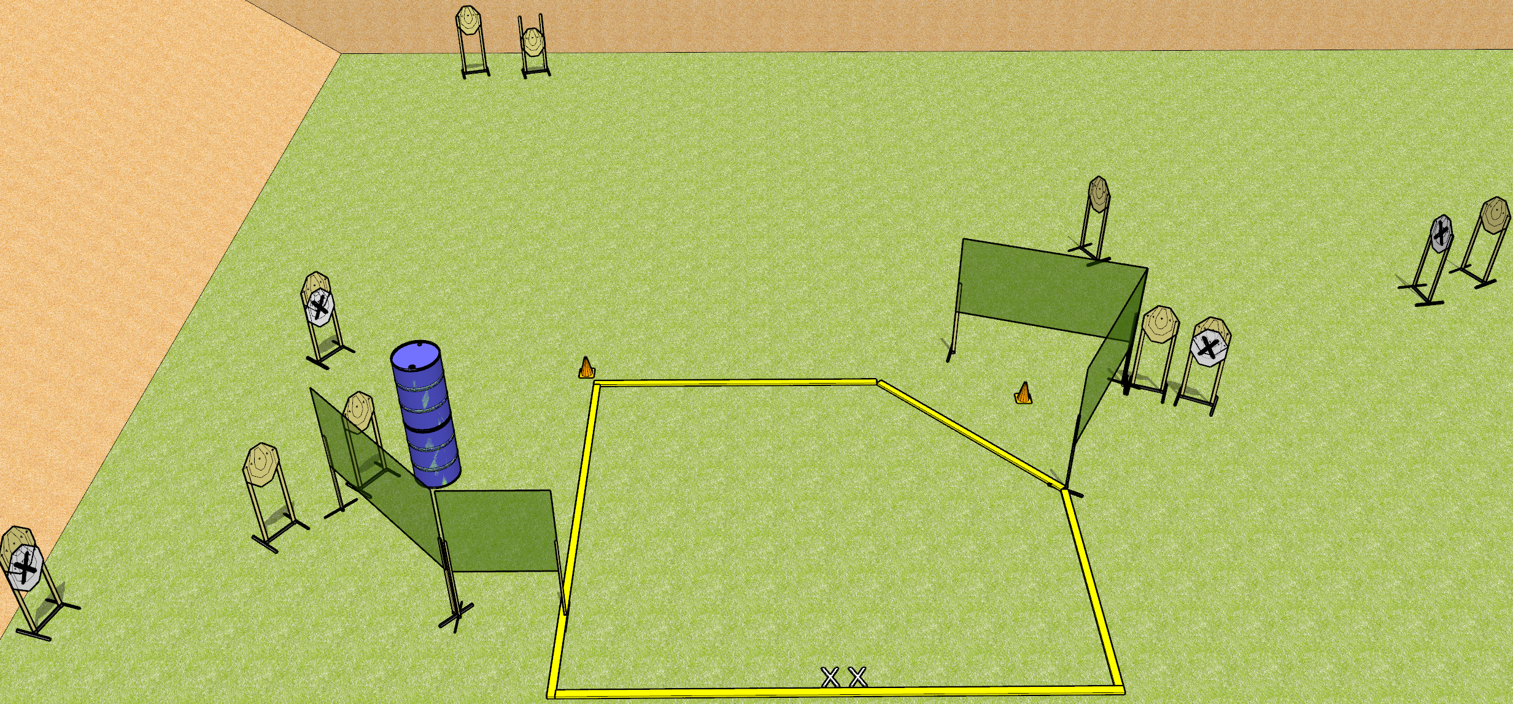
 | Dothan Gun Club – USPSA Match The Sickness Course Designer : Drew Coleman
START POSITION : Standing with both feet on X’s, wrists below belt
GUN READY CONDITION : Pistol loaded and holstered. PCC loaded, shouldered, safety on, pointed at either orange cone. |  | SCORING: Comstock, 20 rounds TARGETS: 10 paper, 0 Steel SCORED HITS: Best 2 on paper, steel until down START-STOP: Audible, last shot RULES:
STAGE PROCEDURE: Engage targets as they become available from within the fault lines.

Slide 6
The Sickness
Written Stage Briefing
The Sickness is a 20 round, 100 point, Comstock Medium Course. There are ten IPSC targets. The best two hits on paper will score. The start signal is audible.
Handgun start position is standing with both feet on X’s, inside the shooting area, wrists below belt. Handgun is loaded and holstered.
PCC start position is standing with both feet on X’s, inside the shooting area. Loaded carbine is held with both hands, safety on, pointed at either orange cone.
Upon start signal, engage targets as they become available from within the fault lines.

Slide 7
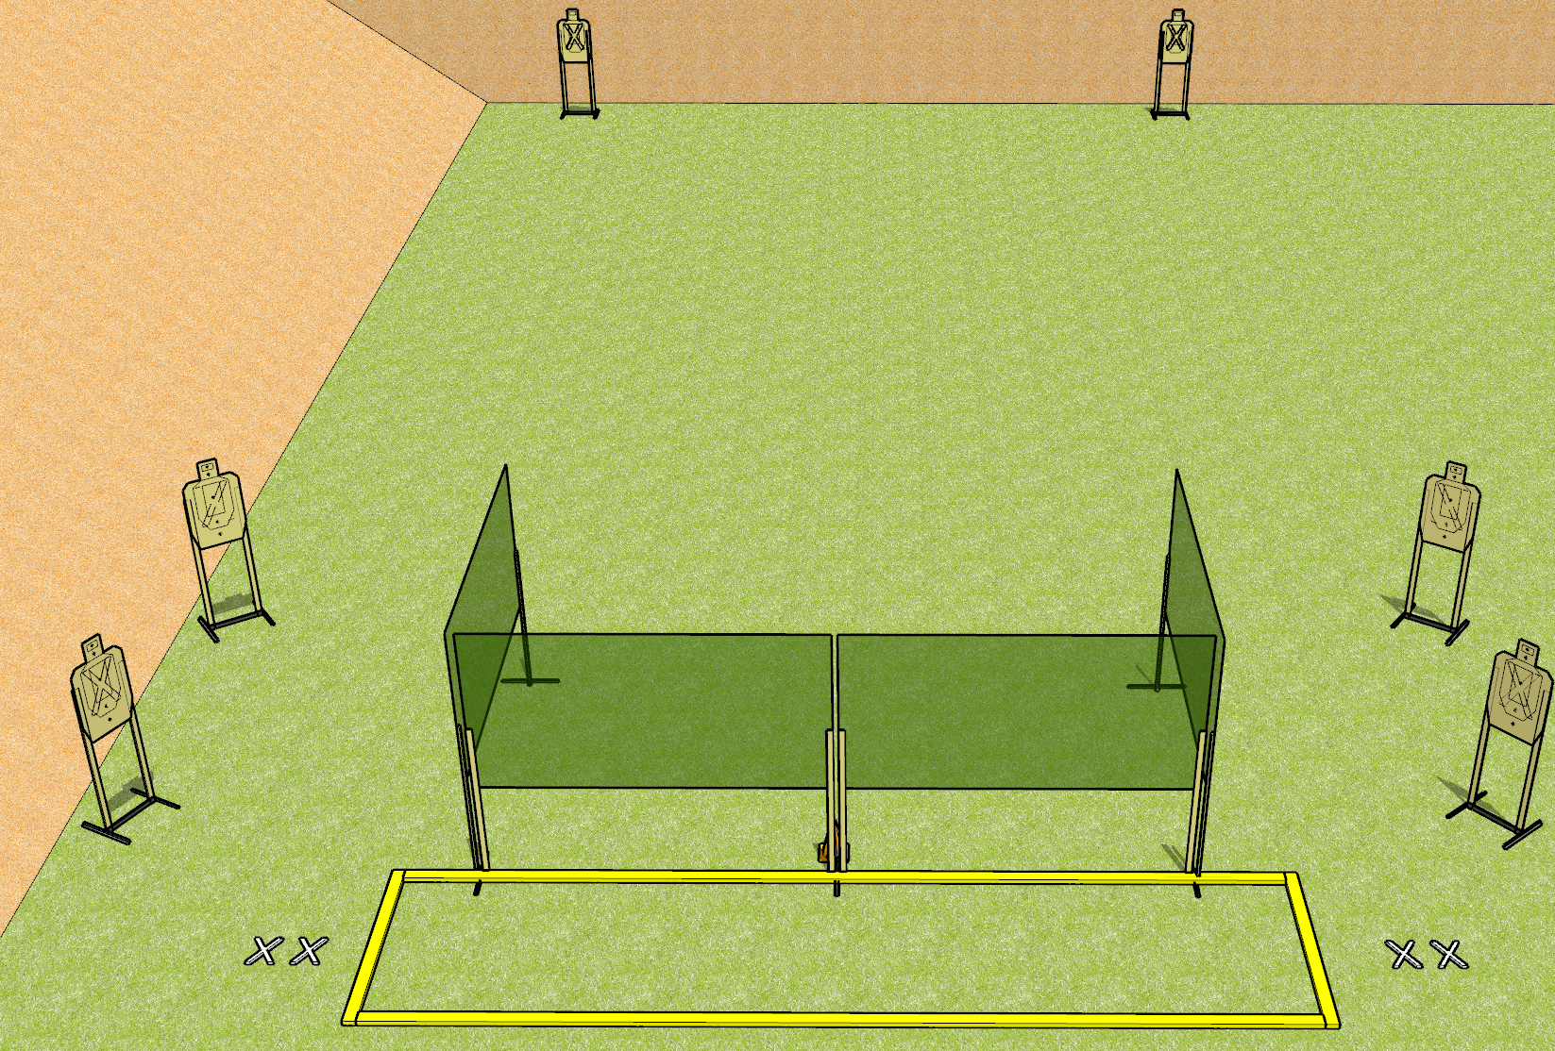
 | Dothan Gun Club – USPSA Match Bring Me Your Hate Course Designer : Drew Coleman
START POSITION : String 1: Standing with both feet on either set of X’s, wrists below belt. String 2: Standing with both feet on opposite set of X’s from string 1, wrists below belt.
GUN READY CONDITION : Pistol loaded and holstered. PCC loaded, shouldered, safety on, pointed at orange cone. |  | SCORING: Virginia Count, 24 rounds TARGETS: 6 paper, 0 Steel SCORED HITS: Best 4 on paper, steel until down START-STOP: Audible, last shot RULES:
STAGE PROCEDURE: String 1: Engage T1-T3 OR T4-T6 with only two rounds each, perform a mandatory reload, then engage remaining array with only two rounds each. String 2: Engage T1-T3 OR T4-T6 with only two rounds each, perform a mandatory reload, then engage remaining array with only two rounds each strong hand only.
T3
T4
T2
T5
T1
T6

Slide 8
Bring Me Your Hate
Written Stage Briefing
Bring Me Your Hate is a 24 round, 120 point, Virginia Count Standard Exercise. There are six USPSA targets. The best four hits on paper will score. The start signal is audible. There are two strings of fire.
Handgun start position for string one is standing with both feet on either set of X’s with pistol loaded and holstered, wrists below belt. The start position for string two is standing with both feet on the opposite set of X’s with pistol loaded and holstered, wrists below belt.
PCC start position for string one is standing with both feet on either set of X’s with loaded carbine held with both hands, safety on, shouldered, pointed at either orange cone. The start position for string two is standing on the opposite set of X’s with loaded carbine held with both hands, safety on, shouldered, pointed at either orange cone.
Targets are designated T1 through T6, from left to right per the stage diagram. Stage procedure for string one is to engage T1-T3 OR T4-T6 from within the shooting area with only two rounds each, perform a mandatory reload, then engage the remaining array with only two rounds each. Stage procedure for string two is to engage T1-T3 OR T4-T6 from within the shooting area with only two rounds each, perform a mandatory reload, then engage the remaining array with only two rounds each strong hand only.

Slide 9
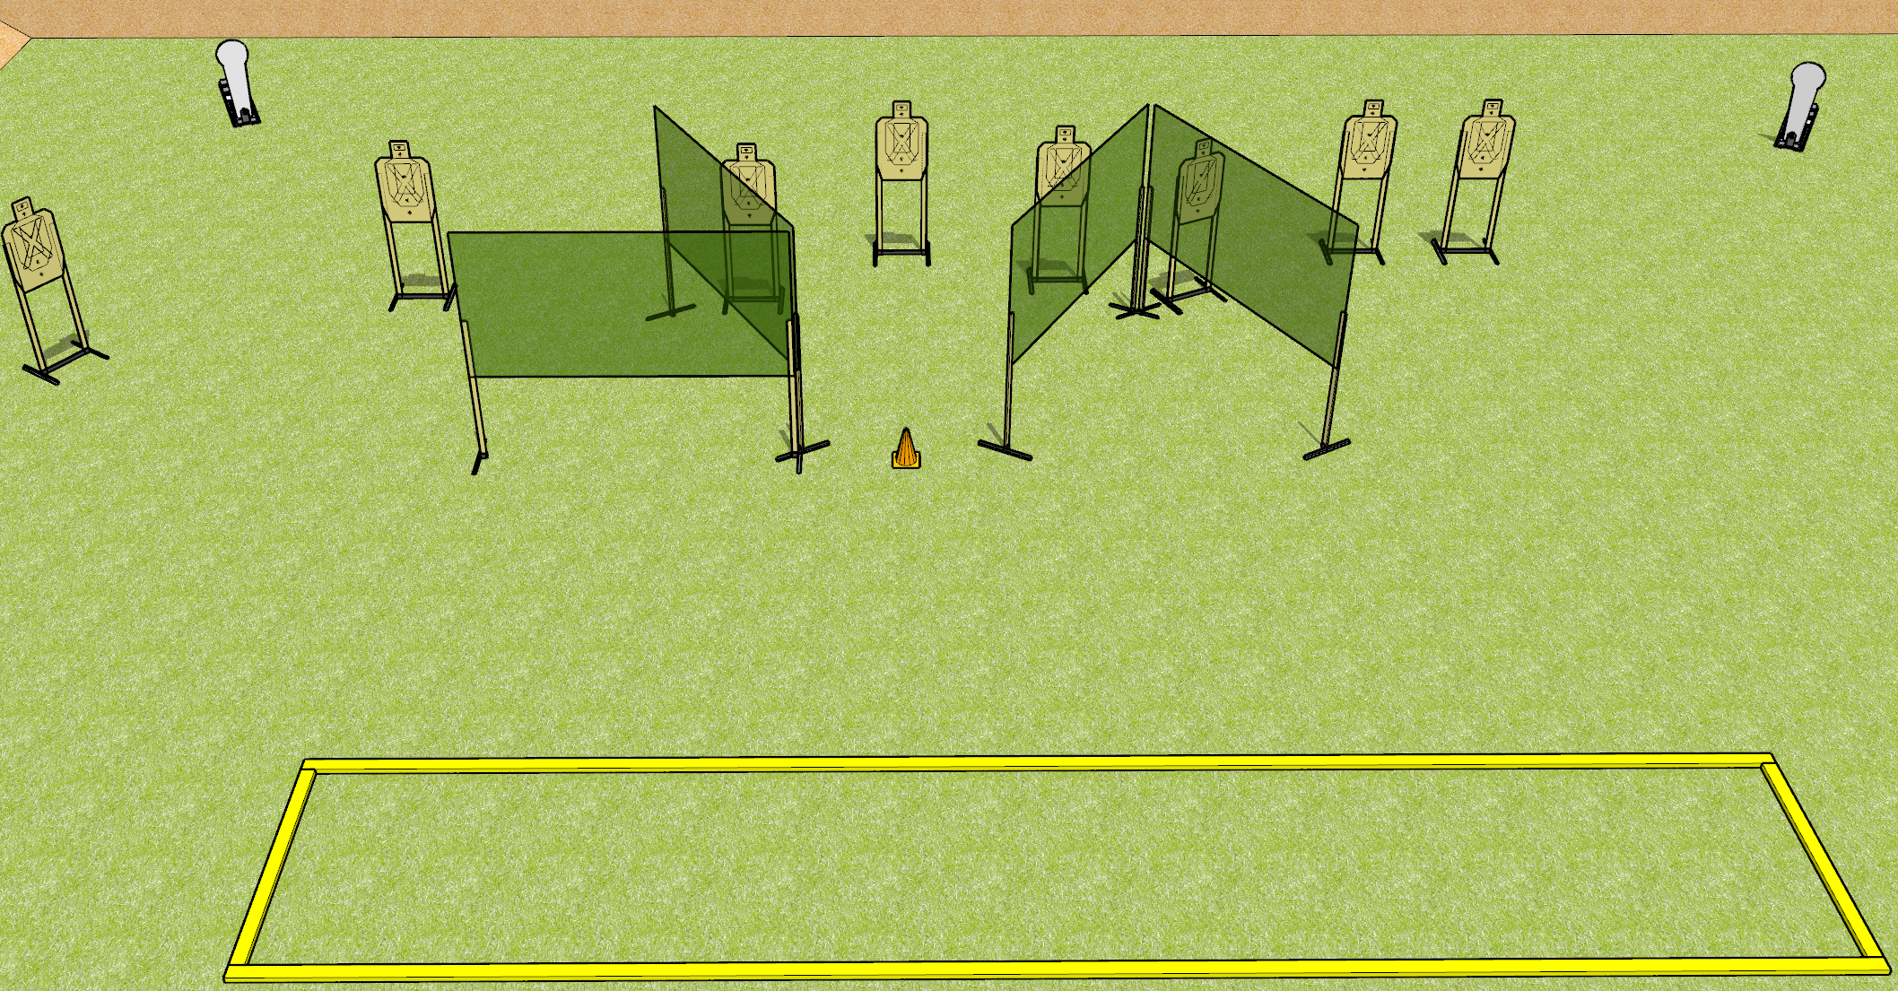
 | Dothan Gun Club – USPSA Match Something Borrowed Course Designer : Drew Coleman
START POSITION : Standing with both feet outside the shooting area, wrists below belt
GUN READY CONDITION : Pistol loaded and holstered. PCC loaded, shouldered, safety on, pointed at orange cone. |  | SCORING: Comstock, 26 rounds TARGETS: 8 paper, 2 Steel SCORED HITS: Best 3 on paper, steel until down START-STOP: Audible, last shot RULES:
STAGE PROCEDURE: Engage targets as they become available from within the fault lines.

Slide 10
Something Borrowed
Written Stage Briefing
Something Borrowed is a 26 round, 130 point, Comstock Long Course. There are eight USPSA targets and two Colt Poppers. The best three hits per paper target will score and steel must fall to score. The start signal is audible.
Handgun start position is standing with both feet outside of the shooting area, wrists below belt. Handgun is loaded and holstered.
PCC start position is standing with both feet outside the shooting area. Loaded carbine is held with both hands, safety on, shouldered, pointed at orange cone.
Upon start signal, engage targets as they become available from within the shooting area.
Admin note: yes I did steal this from nationals.

Slide 11
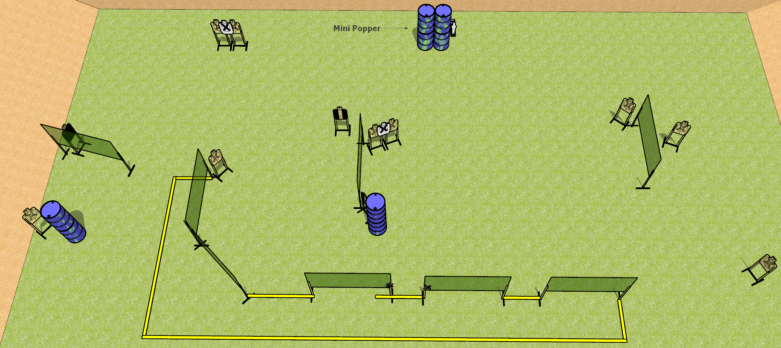
 | Dothan Gun Club – USPSA Match And I Said Hey Course Designer : Drew Coleman
START POSITION : Standing with both hands touching marks
GUN READY CONDITION : Pistol loaded and holstered. PCC loaded, shouldered, safety on, muzzle touching a mark. |  | SCORING: Comstock, 26 rounds TARGETS: 12 paper, 2 Steel SCORED HITS: Best 2 on paper, steel until down START-STOP: Audible, last shot RULES:
STAGE PROCEDURE: Engage targets as they become available from within the fault lines.

Slide 12
And I Said Hey
Written Stage Briefing
And I Said Hey is a 26 round, 130 point, Comstock Field Course. There are twelve USPSA targets and two mini poppers. The best two hits on paper will score. Steel must fall to score. The start signal is audible.
Handgun start position is standing with both hands touching marks. Pistol is loaded and holstered.
PCC start position is standing with loaded carbine held with both hands, safety on, muzzle touching either mark.
Upon start signal, engage targets as they become available from the shooting area.

Slide 13
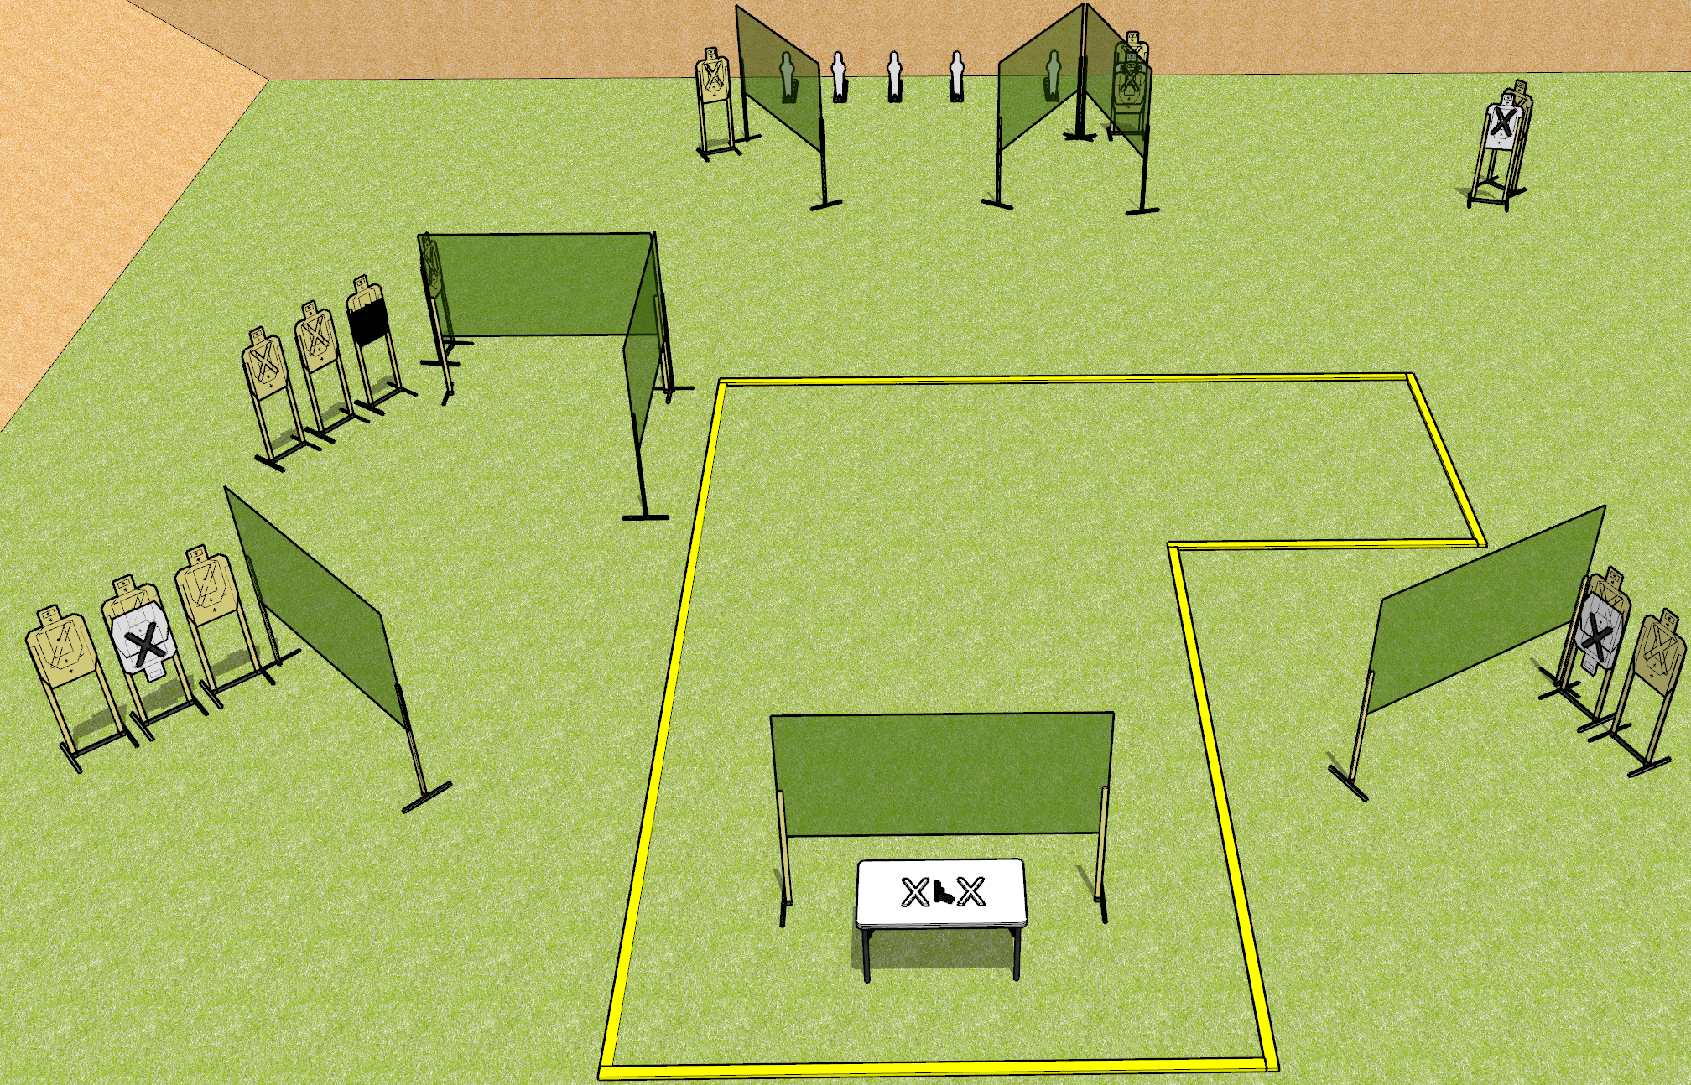
 | Dothan Gun Club – USPSA Match Horsing Around Course Designer : Drew Coleman
START POSITION : Standing with both hands palms flat covering X’s on table.
GUN READY CONDITION : Firearm loaded, safety on, pointed squarely down range, trigger guard on mark. |  | SCORING: Comstock, 31 rounds TARGETS: 13 paper, 5 Steel SCORED HITS: Best 2 on paper, steel until down START-STOP: Audible, last shot RULES:
STAGE PROCEDURE: Engage targets as they become available from within the fault lines.

Slide 14
Horsing Around
Written Stage Briefing
Horsing Around is a 31 round, 155 point, Comstock Long Course. There are thirteen USPSA targets and five mini-poppers. The best two hits on paper will score and steel must fall to score. The start signal is audible.
Handgun start position is with both hands covering marks with palms. Handgun is loaded, lying unsupported on table, with trigger guard on mark. Muzzle must be pointed squarely down range.
Handgun start position is with both hands covering marks with palms. Carbine is loaded, safety on, lying unsupported on table, with trigger guard on mark. Muzzle must be pointed squarely down range.
Upon start signal, engage targets as they become available from within the fault lines.

Slide 15
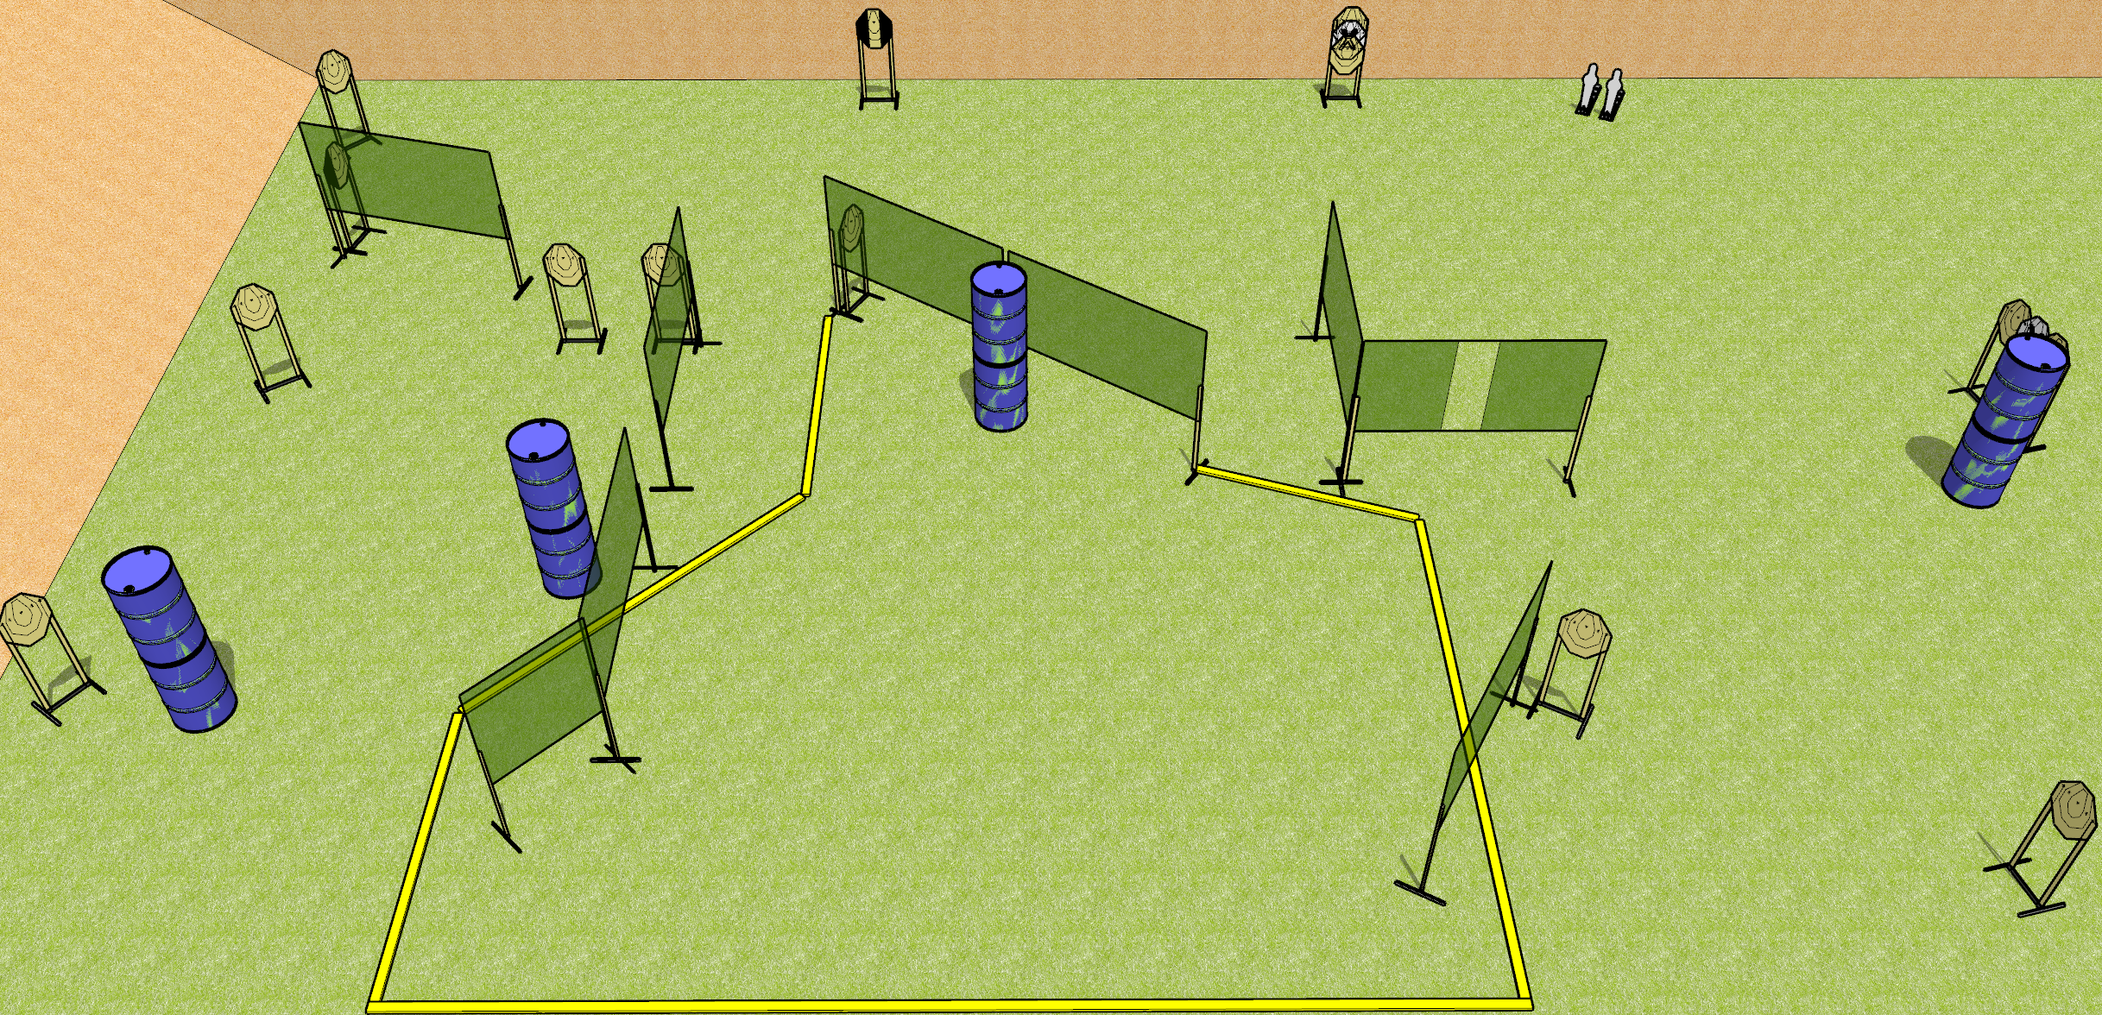
 | Dothan Gun Club – USPSA Match Whatchamacallit Course Designer : Drew Coleman
START POSITION : Standing anywhere completely outside the shooting area, wrists below belt.
GUN READY CONDITION : Pistol loaded and holstered. PCC loaded, safety on, buttstock on belt. |  | SCORING: Comstock, 30 rounds TARGETS: 14 paper, 2 Steel SCORED HITS: Best 2 on paper, steel until down START-STOP: Audible, last shot RULES:
STAGE PROCEDURE: Engage targets as they become available from within the fault lines.

Slide 16
Whatchamacallit
Written Stage Briefing
Whatchamacallit is a 30 round, 150 point, Comstock Field Course. There are fourteen IPSC targets and two mini poppers. The best two hits on paper will score, and steel must fall to score. The start signal is audible.
Handgun start position is standing anywhere completely outside the shooting area, wrists below belt. Handgun is loaded and holstered.
PCC start position is standing anywhere completely outside the shooting area. Carbine is loaded, held with both hands, safety on, buttstock on belt, pointed in a safety direction.
Upon start signal, engage the targets as they become available from within the shooting area.

Slide 17
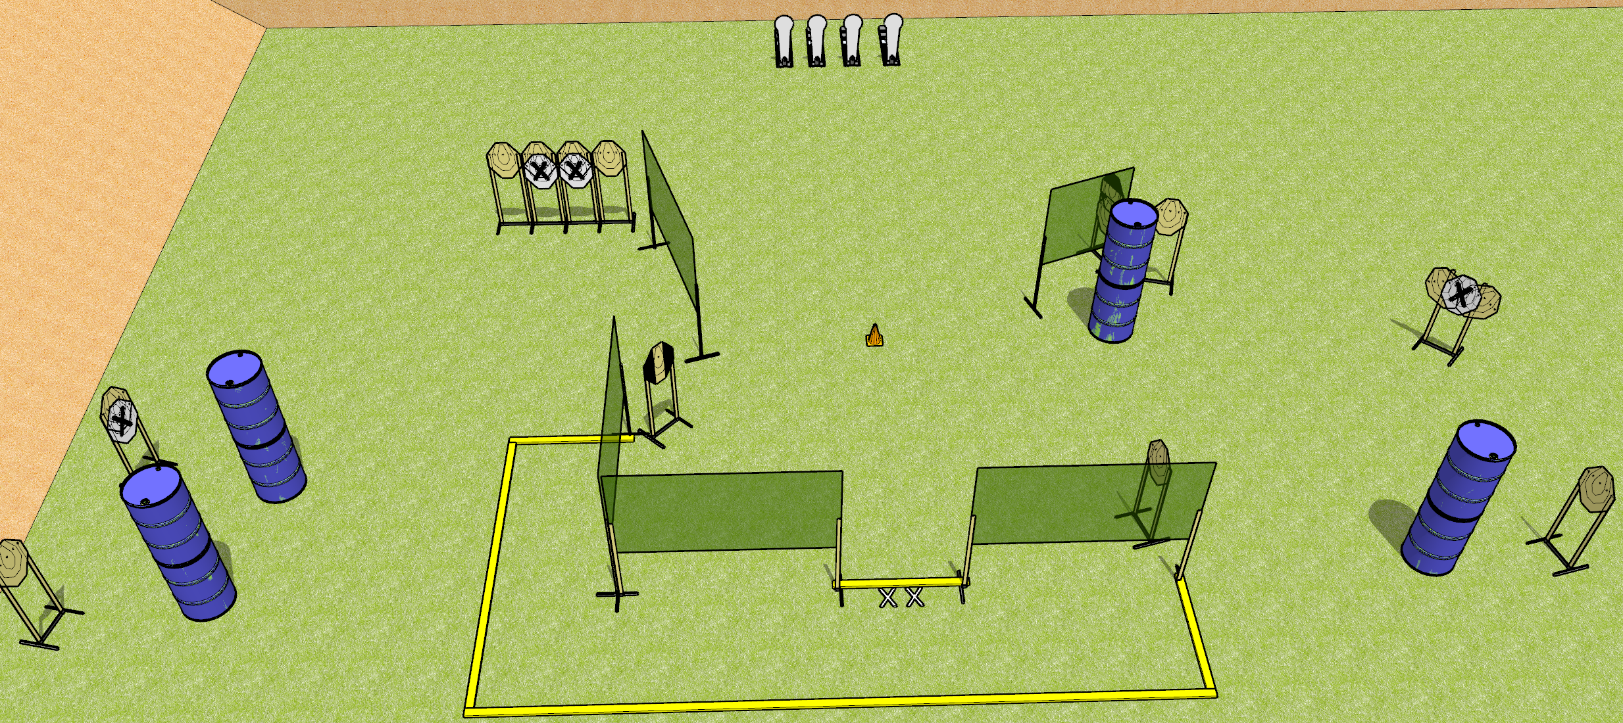
 | Dothan Gun Club – USPSA Match Pain for Dinner Course Designer : Drew Coleman
START POSITION : Standing with both feet on X’s. Hands relaxed at sides.
GUN READY CONDITION : Pistol loaded and holstered. PCC buttstock on belt, safety on, pointed at orange cone. |  | SCORING: Comstock, 32 rounds TARGETS: 14 paper, 4 Steel SCORED HITS: Best 2 on paper, steel until down START-STOP: Audible, last shot RULES:
STAGE PROCEDURE: Engage targets as they become available from within the fault lines

Slide 18
Pain for Dinner
Written Stage Briefing
Pain for Dinner is a 32 round, 160 point, Comstock Field Course. There are fourteen IPSC targets and four Colt poppers. The best two hits on paper will score, and steel must fall to score. The start signal is audible.
Handgun start position is standing with both feet on X’s, wrists below belt. Handgun is loaded and holstered.
PCC start position is standing with both feet on X’s. Carbine is loaded, held with both hands, safety on, muzzle pointed at orange cone.
Upon start signal, engage the targets as they become available from within the shooting area.

